Slide 1
UNIT TWO
STANDARD SYSTEM REPRESENTATION
BLOCK DIAGRAM
SIGNAL FLOW

Slide 2
STANDARD SYSTEM REPRESENTATION
There are four standard ways of representing physical systems:
Block diagrams
Signal flow diagrams
Mathematical representation example, (Mechanical, electrical, pneumatics and hydraulics)
State space representation

Slide 3
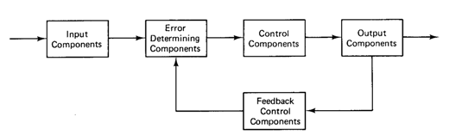
Block Diagrams
A block diagram of a system is a pictorial representation of the functions performed by each component of the system and shows the flow of signals.
Blocks are used to represent the various parts of the system’s operation.
The basic elements of block diagram are block, take-off point and summing point.
A generic block diagram for an automatic control system

Slide 4
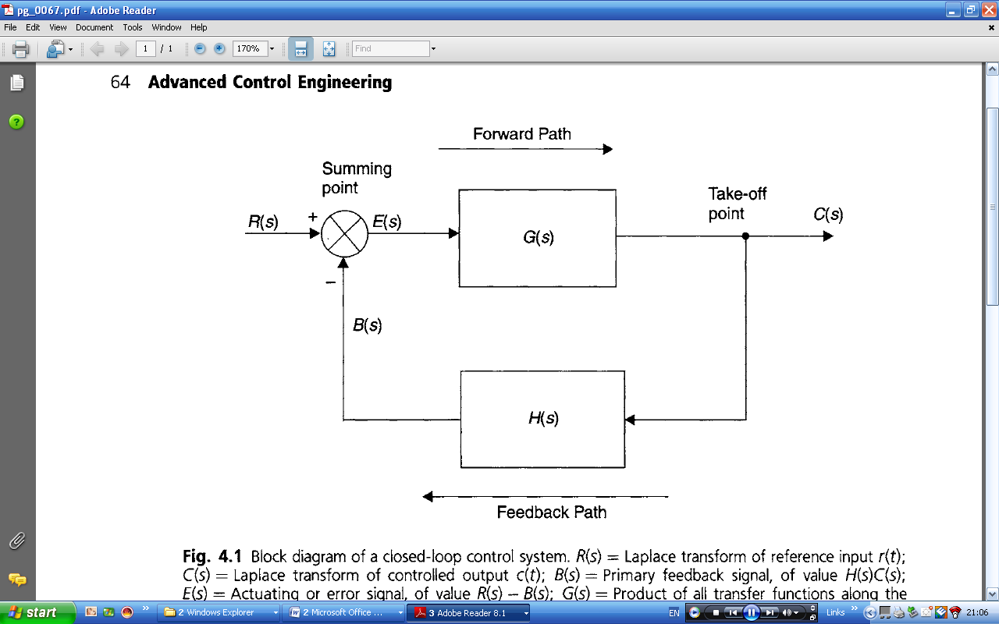
Determination of Overall Transfer Function
The block diagram of a control system with negative feedback can often be simplified to the form shown:

Slide 5
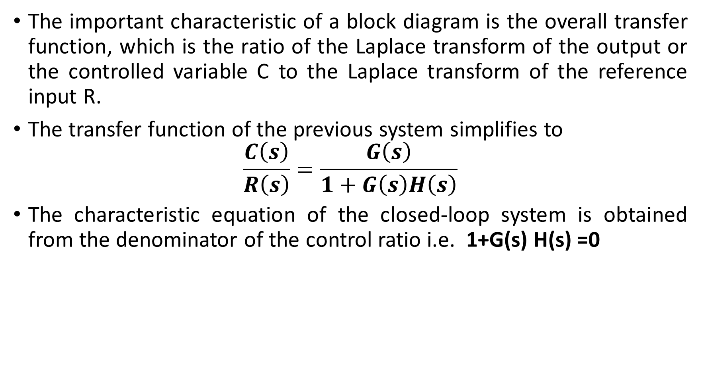
The important characteristic of a block diagram is the overall transfer function, which is the ratio of the Laplace transform of the output or the controlled variable C to the Laplace transform of the reference input R.
The transfer function of the previous system simplifies to
$$\frac{C\left(s\right)}{R\left(s\right)}=\frac{G\left(s\right)}{1+G\left(s\right)H\left(s\right)}$$
The characteristic equation of the closed-loop system is obtained from the denominator of the control ratio i.e. 1+G(s) H(s) =0

Slide 6
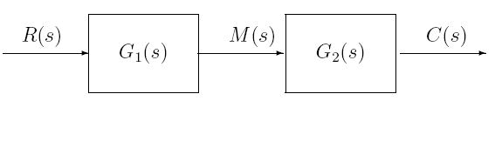
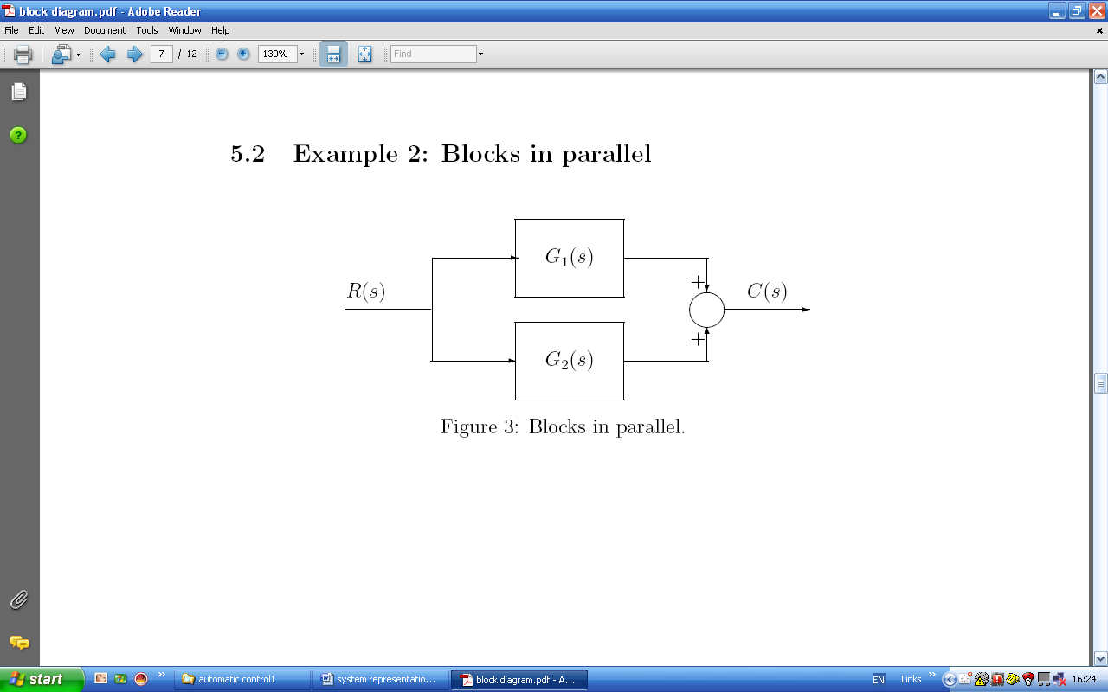
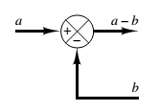
Block diagram transformation theorems
Blocks in series:
Blocks in parallel:
Summation point:

Slide 7
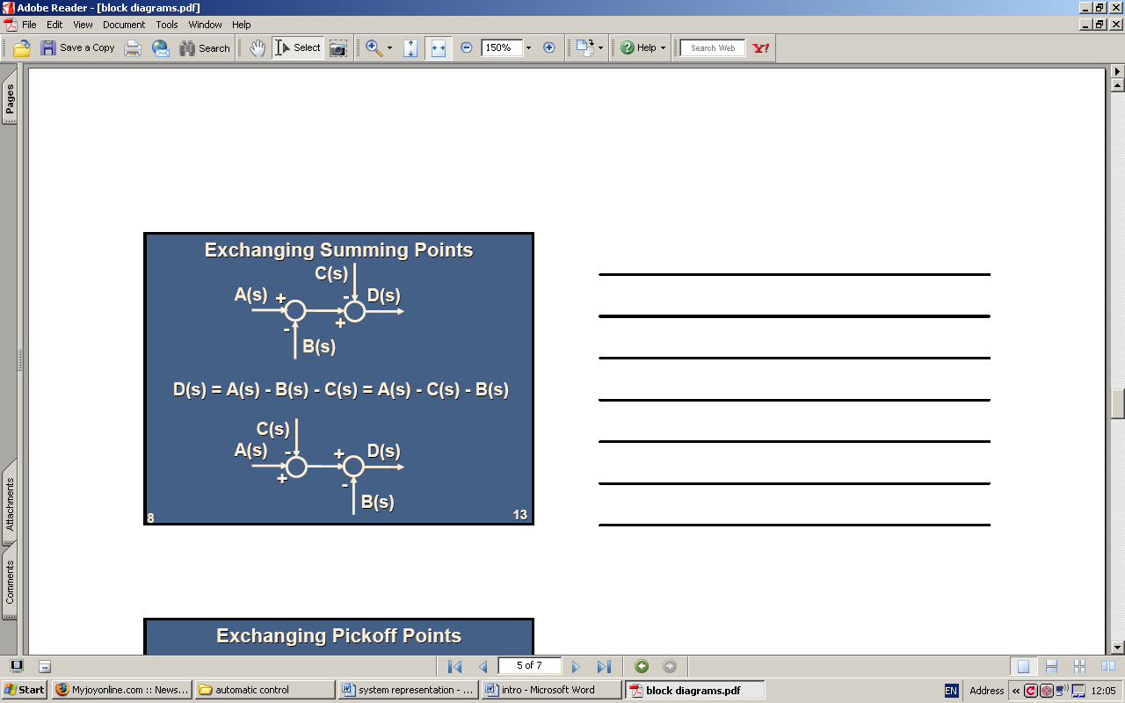
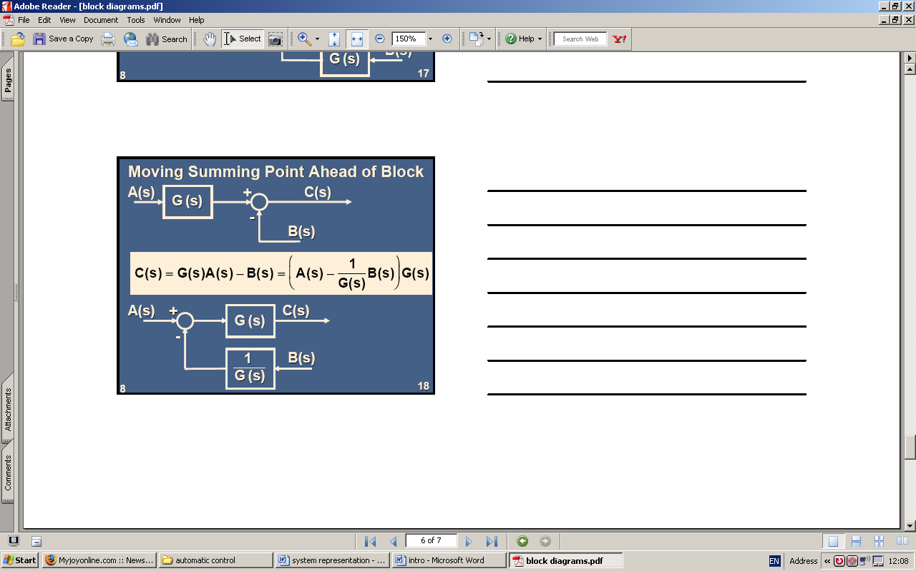
Exchanging summing points:
Moving summing point ahead of block:

Slide 8
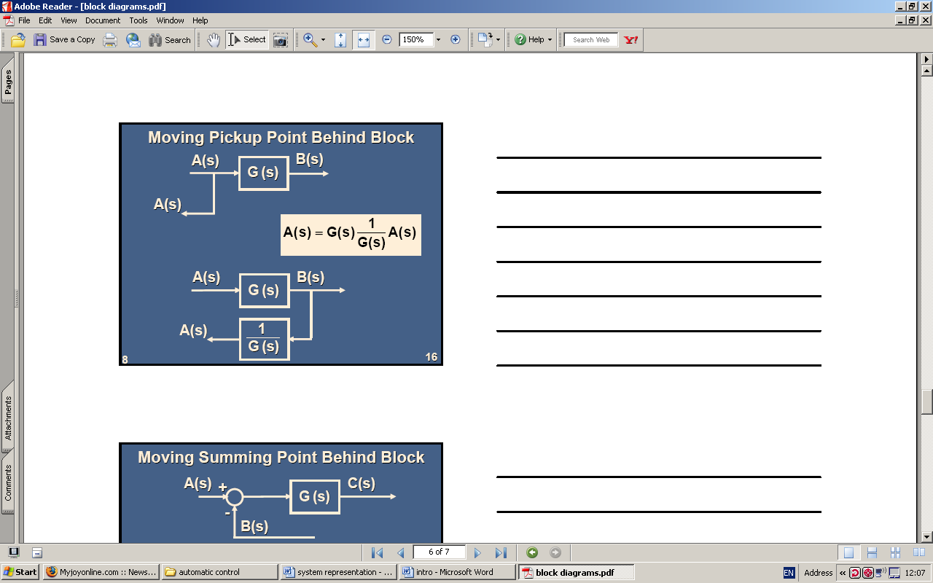
Moving pick up point behind block:

Slide 9
Block Diagram Reduction
Reducing the block diagram to a single block is an easy way to get the relationship between C(s) (output) and R(s) (input).
We can do this by rearranging or manipulating the blocks.
The following steps are used to simplify block diagrams:
Combine all cascade blocks using transformation 1.
Combine all parallel blocks using transformation 2.
Eliminate all minor feedback loops using transformation 4.
Shift summing points to the left and take off points to the right of the major loop.
Repeat steps 1 to 4 for each input as required.

Slide 10
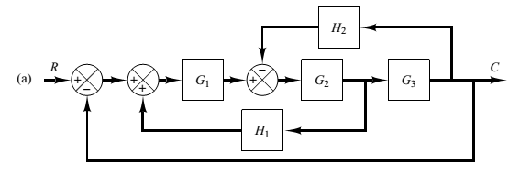
Consider the system shown in Figure (a).
By moving the summing point of the negative feedback loop containing H2 outside the positive feedback loop containing H1, we obtain Figure (b).
Eliminating the positive feedback loop, we have Figure (c).
The elimination of the loop containing H2/G1 gives Figure (d).
Finally, eliminating the feedback loop results in Figure 2–13(e).

Slide 11
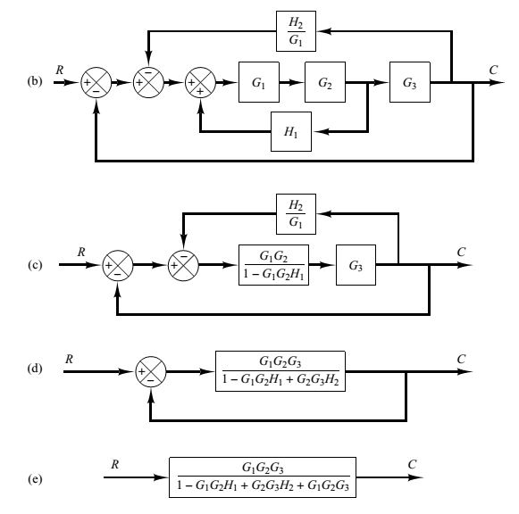

Slide 12
Superposition of multiple inputs
Linear systems with multiple inputs are analyzed as follows:
Set all inputs except one to zero,
Transform the block diagram to canonical form using the transformation sheet.
Calculate the response due to the chosen input acting alone.
Repeat steps 1 to 3 for each of the remaining input
Algebraically add all the responses (outputs) determined from steps 1 to 4. This sum is the total output acting simultaneously.
NB: This is applicable only if the system is linear.

Slide 13
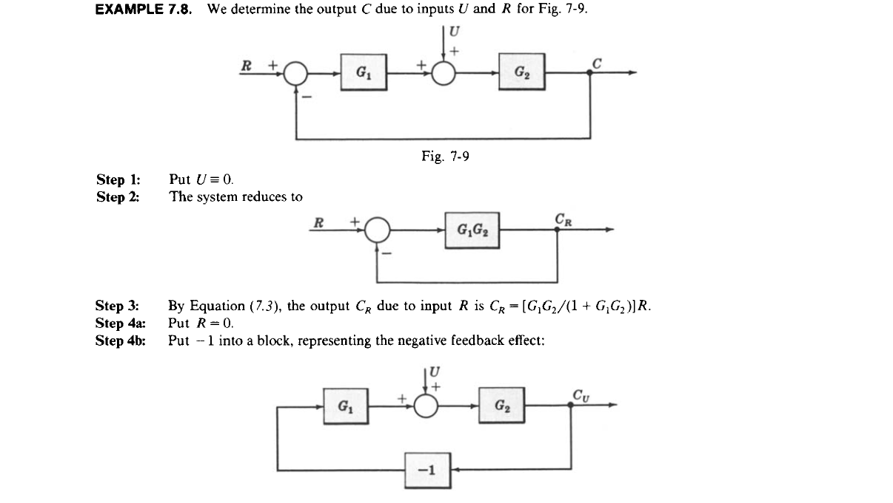
Example

Slide 14
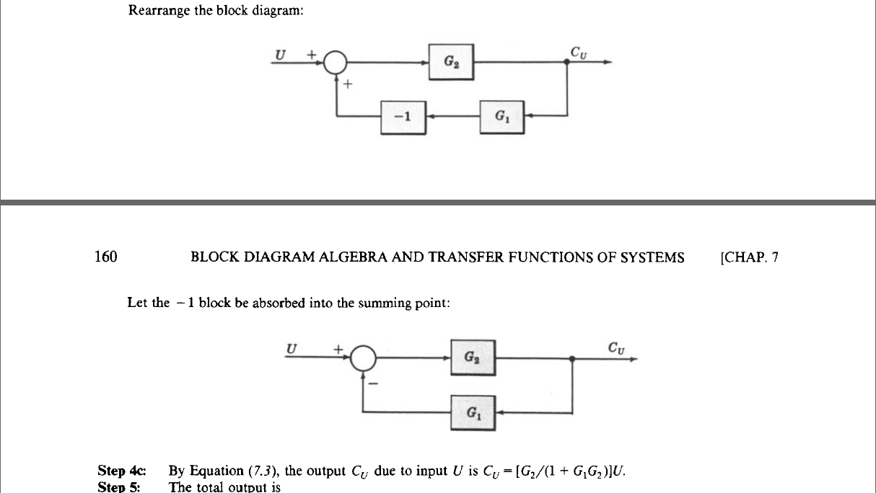

Slide 15
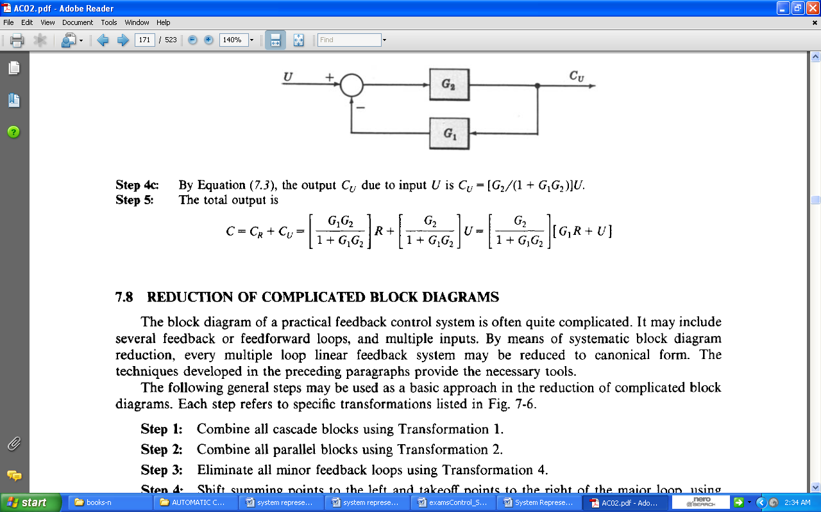

Slide 16
Signal Flow
It is a pictorial representation of the simultaneous equations describing a system.
In signal flow graphs, the dependent and independent variables are represented by nodes, while the transmittance is represented by the branch between respective nodes.
A branch has the following properties:
It is a line joining two nodes which has a direction represented by an arrow.
Branch has magnitude which is called the transmittance, branch gain or transfer function. This magnitude is determined by the relationship between two nodes.

Slide 17
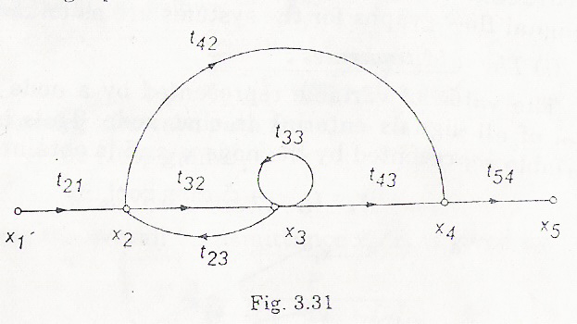
Various terms used in signal flow graphs are illustrated on the figure below.
Path
Source node
Sink node
Mixed node
Forward path
Feedback path
Self loop
Path gain
Loop gain

Slide 18
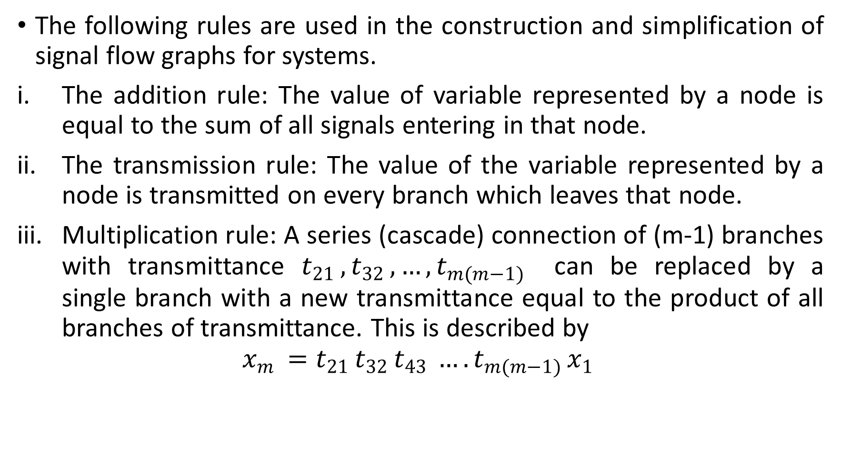
The following rules are used in the construction and simplification of signal flow graphs for systems.
The addition rule: The value of variable represented by a node is equal to the sum of all signals entering in that node.
The transmission rule: The value of the variable represented by a node is transmitted on every branch which leaves that node.
Multiplication rule: A series (cascade) connection of (m-1) branches with transmittance $t_{21 },t_{32 },…,t_{m(m−1) }$ can be replaced by a single branch with a new transmittance equal to the product of all branches of transmittance. This is described by
$$x_{m }=t_{21 }t_{32 }t_{43 }…. t_{m(m−1) }x_{1 }$$

Slide 19
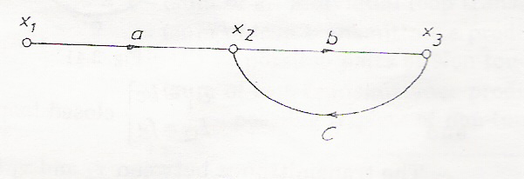

Example: Draw the signal flow graph of the following equations.
$x_{2}=ax_{1 }+cx_{3 }$ $x_{3}=bx_{2 }$
Solution
Considering $x_{1 }$as the input node and $x_{3}$ as the output node, the signal flow graph is drawn as shown below:

Slide 20
Constructing Signal Flow Graph from Block Diagram
The following rules are used for converting signal flow graphs to block diagrams:
Variables, summing points, and take-off points are represented by nodes.
If a summing point is placed before take-off points in the direction of signal flow, then in such a case represent the summing point and the take-off by a single node.
If a summing point is placed after take-off points in the direction of signal flow, then in such a case represent the summing point and the take-off by separate nodes connected with a line having transmittance of unity.
Transfer function is represented by a line which is directed in the direction of signal flow.

